Slide 1
EE2331 Data Structures and Algorithms
Trees

Slide 2
Trees
Tree is a non-linear linked data structure
Multiple succeeding elements
Tree structure is recursively defined, so tree operations often involve recursion and linked list

Slide 3
Outline
Terminology
Representation
Binary Trees
Implementations with Array and Linked List
Common Operations of Binary Tree
Trees Traversal
Preorder, inorder, postorder, level order
Reconstruction of Binary Trees
Special Binary Trees
Binary Search Trees
Applications
General Trees and Other tree structures

Slide 4
An Inverted Tree
root
branches
leaves

Slide 5
Tree Example: Restaurant
root (boss)
Hierarchical structure
Boss
branches
Manager
Chef
Waiter
Waitress
Cook
Cleaner
Leaves (the lowest level)

Slide 6
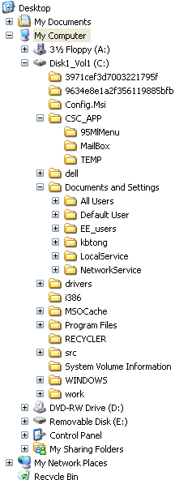

File System
root (desktop)
branches
leaves
Can you think of other examples of “tree” structures?

Slide 7
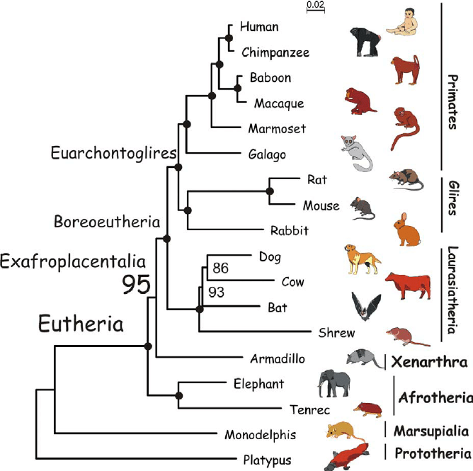
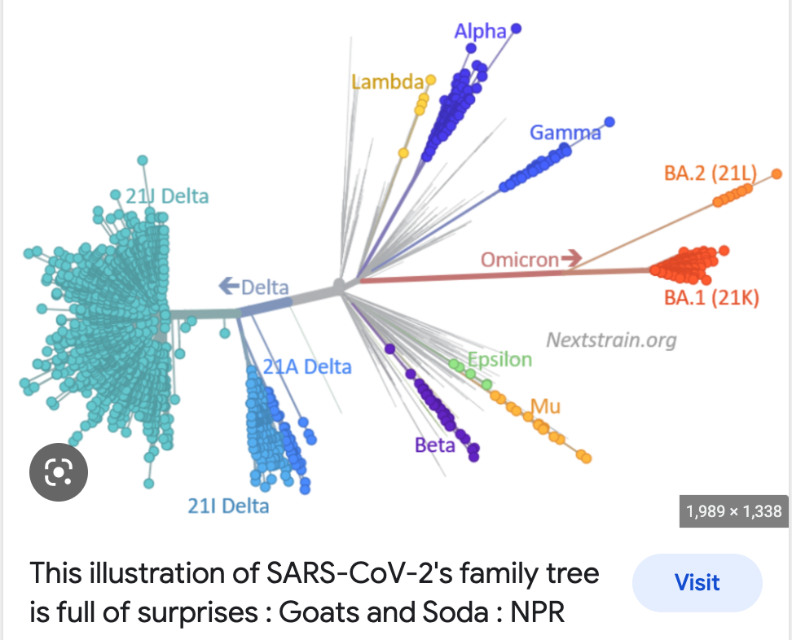
Trees in biology

Slide 8
Definition of trees
is a tree. It is called an “empty tree”
If is a node, and … are non-empty trees (k ≥ 0), then is a tree. When k=0, there is no subtree → a single node is a tree.
Tree examples:
T1
T2
T_{k}
T1
T2
…
T_{k}

Slide 9
Composition of a Tree
Types of tree node
Root node (the top node in a tree)
Interior nodes (nodes with at least one child)
Leaf nodes (nodes with no children)
Root node
Edge
Interior node
Leaf node

Slide 10
Tree Criteria (vs. graph)
Always a single root node
A single path from the root to node
Exercise: which of the following is not a tree?
A
B
C
D
Answer: B and D

Slide 11
Property of Trees
Nodes represent information (data)
Branches represent links between the nodes
If the total number of nodes (i.e. root node, interior nodes and leaf nodes) is n, how many branches in the tree?
Number of branches is ?

Slide 12
Parent, Children & Sibling
This tree has 13 nodes
Node A has 3 children
Nodes B, C and D
Node A is the parent of
B, C and D
Node G is the parent of
Nodes J, K and L
Node G is the child of C
J, K and L are sibling nodes (share the same parent)
A
root
B
C
D
E
F
G
H
I
J
K
L
M

Slide 13
Subtrees
A tree is composed of several subtrees
e.g. root has 3 subtrees
root
root of subtree
1st subtree
2nd subtree
3rd subtree

Slide 14
Smaller subtrees
A subtree can be further broken down into smaller subtrees
root
1st subtree
2nd subtree
3rd subtree
smaller subtrees

Slide 15
Ancestor and Descendant
A simple path is a sequence of nodes n₁, n₂, …, n_{k} such that the nodes are all distinct and there is an edge between each pair of nodes (n₁, n₂), (n₂, n₃), …, (n_{k-1}, n_{k})
The nodes along the simple path from the root to node x are the ancestors of x
The descendants of a node x are the nodes in the subtrees of x
Length of a path = no. of edges on the path
Notes:
Original definition: no. of branches on the path

Slide 16
Degree
The number of subtrees of a node
Degree = 3
root
Degree = 2
Degree = 0

Slide 17
Depth and Level
The depth of a node is the length of the unique path from root to the node.
Depth Level
A
root
0 1
B
C
D
1 2
The level of a node is defined by its depth plus 1.
E
F
G
H
I
2 3
J
K
L
M
3 4
Notes:
Original def :The depth of a node is the number of edges from the root to the node.

Slide 18
Height
Tree’s Height = 3
The height of a node is the number of edges from the node to the deepest leaf.
The height of a tree is a height of the root.
= the longest path in the tree
A
root
3
B
1
C
2
D
2
0
0
1
0
1
E
F
G
H
I
J
0
K
0
L
0
M
0
Notes:
Depth of root = 0
Height of leave = 0

Slide 19
In-class Exercise (no submission needed)
A node having no parent is called Root
A node having no children is called Leaf
A node having both parent and children is called Branch
If a tree has 5 branches, how many nodes does this tree contain? 5+1
What is the degree of a leaf node?
Can a node have more than one parent in a tree?
Is there a unique path from root to every node?

Slide 20
Tree Representation

Slide 21
Representation of Trees
List representation
Set representation
Indentation

Slide 22

List Representation (recursive)
The tree can be represented by this list
(A(B(E, F), C(G(J, K, L)), D(H, I(M))))
A
root
Starting from the root A.
A=A(B,C,D). B, C, and D are not leaf nodes. They are the roots of subtrees. We need to recursively represent them using root(child1, child2, …, the last child). Thus,
B=B(E,F)
C=C(G), G=G(J,K,L)
D=D(H,I), I=I(M)
B
C
D
E
F
G
H
I
J
K
L
M

Slide 23

List Representation (recursive)
The tree can be represented by this list
(A(B(E, F), C(G(J, K, L)), D(H, I(M))))
A
root
What is the list representation of the following tree?
B
C
D
E
F
G
H
I
J
K
L
M

Slide 24
Set Representation
A
D
I
M
B
A
root
F
E
H
B
C
D
C
G
L
J
K
E
F
G
H
I
J
K
L
M

Slide 25
Indentation Representation
A
B
E
F
A
root
C
G
J
B
C
D
K
L
D
E
F
G
H
I
H
I
M
J
K
L
M

Slide 26
They Are Also Indentation
A
B
E
F
C
G
J
K
L
D
H
I
M

